Slide 1

Rockbuster Stealth Data Analysis Project
By Emilia Slav

Slide 2
Rockbuster Database analysis
Main purpose of this analysis is to launch a strategy for the new online video rental service.
Rockbuster data set contains information about Rockbuster’s film, inventory, customers and payments, among other things.

Slide 3

The analysis covers below points ↓
https://public.tableau.com/app/profile/emilia.slav/viz/Achievment3_10/RockbusterStealthDataAnalysisProject

Slide 4
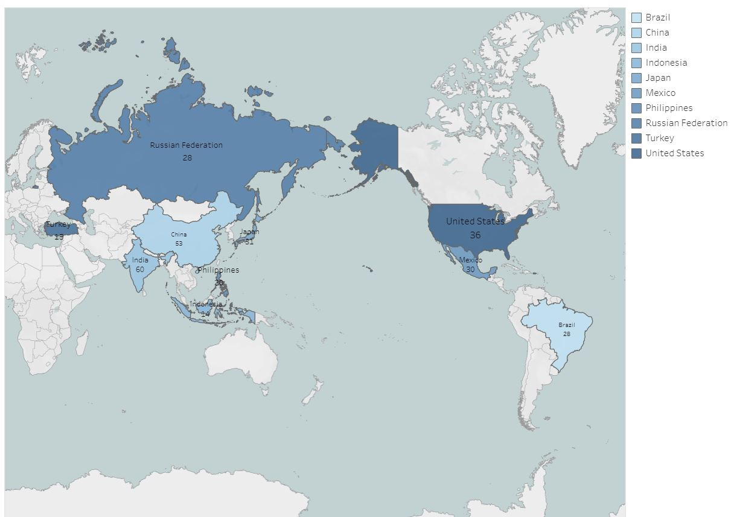
Top 10 countries for Rockbuster in terms of customer numbers

Slide 5
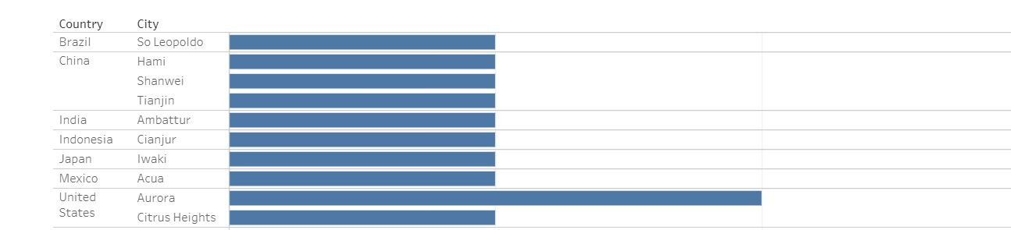
Top 10 cities within the top countries identified

Slide 6
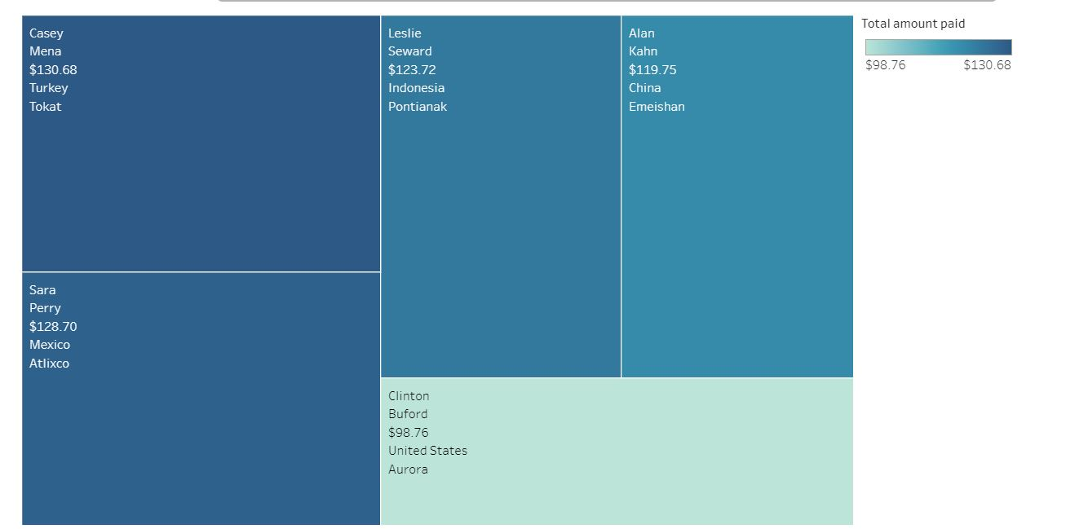
Top 5 customers in the top 10 cities who have paid the highest total amounts to the Rockbuster

Slide 7

Recommendations
Rockbuster should invest more in the
Customers, Cities and Countries
mentioned below for better profit.

